Slide 1
Sequences and Series(Sums)

Slide 2
Section Summary
Sequences.
Examples: Geometric Progression, Arithmetic Progression
Recurrence Relations
Example: Fibonacci Sequence
Summations

Slide 3
Introduction
Sequences are ordered lists of elements.
EXAMPLES:
1, 2, 3, 5, 8
1, 3, 9, 27, 81, …….
1, 2, 3, 4, 5, …
4, 8, 12, 16, 20,…
2, 4, 8, 16, 32, …
1, 1/2, 1/3, 1/4, 1/5, …
1, 4, 9, 16, 25, …
1, -1, 1, -1, 1, -1, …
Sequences arise throughout mathematics, computer science, and in many other disciplines, ranging from botany to music.
We will introduce the terminology to represent sequences and sums of the terms in the sequences.

Slide 4
SEQUENCES IN COMPUTER PROGRAMMING:
An important data type in computer programming consists of finite sequences known as one-dimensional arrays; a single variable in which a sequence of variables may be stored.
EXAMPLE:
The names of k students in a class may be represented by an array of k elements “name” as:
name [0], name[1], name[2], …, name[k-1]

Slide 5
Sequences
Definition: A sequence is a function from a subset of the integers (usually either the set {0, 1, 2, 3, 4, …..} or {1, 2, 3, 4, ….} ) to a set S.
The notation a_{n} is used to denote the image of the integer n. We can think of a_{n} as the equivalent of f(n) where f is a function from {0,1,2,…..} to S. We call a_{n} a term of the sequence.
OR
A sequence is just a list of elements usually written in a row.

Slide 6
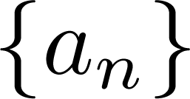
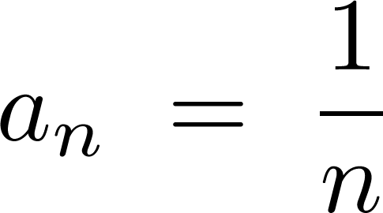
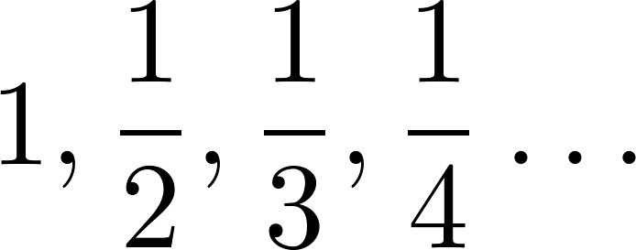
Sequences
Example: Consider the sequence where

Slide 7
Sequences
EXAMPLE:
Write the first four terms of the sequence defined by the formula: bj = 1 + $2^{j}$, for all integers j ≥ 0
SOLUTION:
b0 = 1 + $2^{0}$ = 1 + 1 = 2
b1 = 1 + $2^{1}$ = 1 + 2 = 3
b2 = 1 + $2^{2}$ = 1 + 4 = 5
b3 = 1 + $2^{3}$ = 1 + 8 = 9
REMARK:
The formula bj = 1 + $2^{j}$, for all integers j ≥ 0 defines an infinite sequence having infinite number of values.

Slide 8
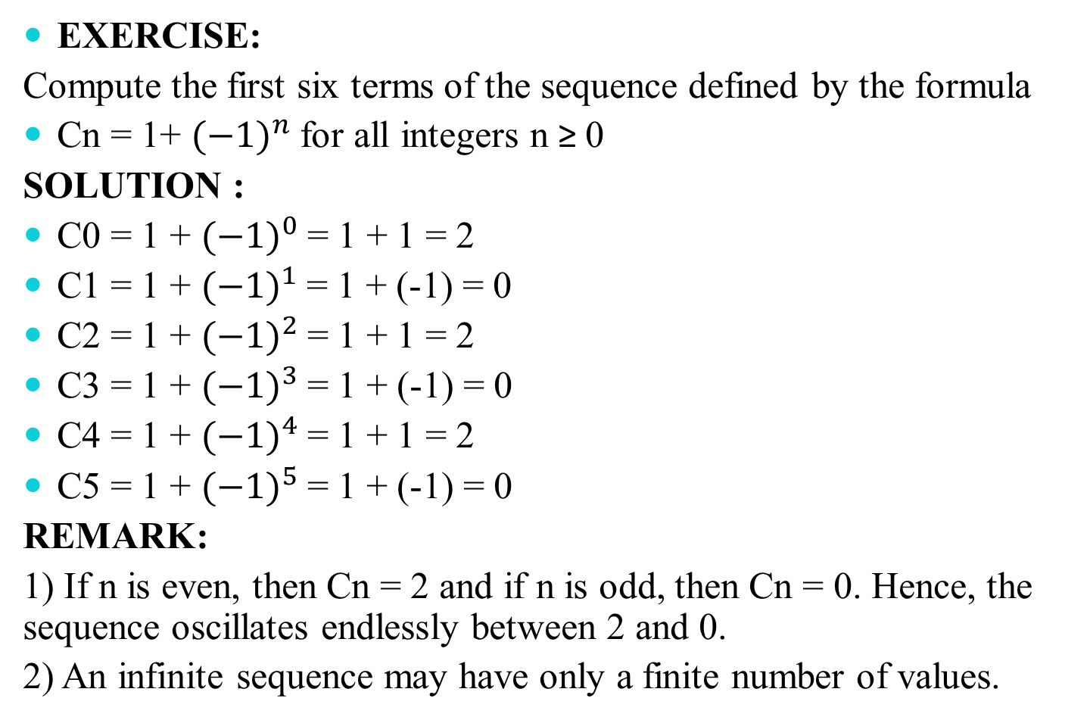
Sequences
EXERCISE:
Compute the first six terms of the sequence defined by the formula
Cn = 1+ ${(−1)}^{n}$for all integers n ≥ 0
SOLUTION :
C0 = 1 + ${(−1)}^{0}$= 1 + 1 = 2
C1 = 1 + ${(−1)}^{1}$= 1 + (-1) = 0
C2 = 1 + ${(−1)}^{2}$= 1 + 1 = 2
C3 = 1 + ${(−1)}^{3}$= 1 + (-1) = 0
C4 = 1 + ${(−1)}^{4}$= 1 + 1 = 2
C5 = 1 + ${(−1)}^{5}$= 1 + (-1) = 0
REMARK:
1) If n is even, then Cn = 2 and if n is odd, then Cn = 0. Hence, the sequence oscillates endlessly between 2 and 0.
2) An infinite sequence may have only a finite number of values.

Slide 9
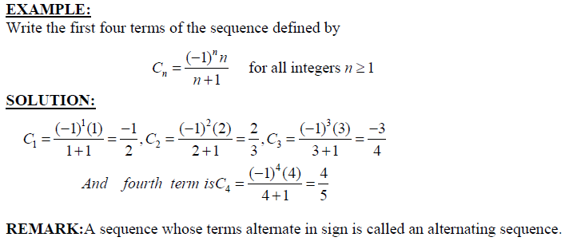
Sequences

Slide 10
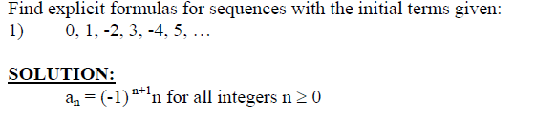
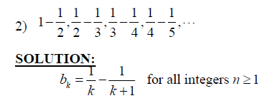
Sequences

Slide 11
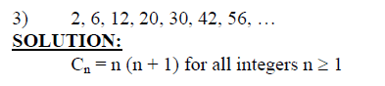
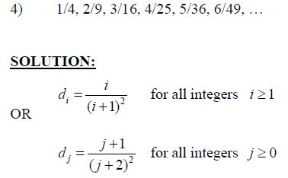
Sequences

Slide 12
Arithmetic Progression OR Sequences
A sequence in which every term after the first is obtained from the preceding term by adding a constant number is called an arithmetic sequence or arithmetic progression (A.P.)
The constant number, being the difference of any two consecutive terms is called the common difference of A.P., commonly denoted by “d”.
EXAMPLES:
1. 5, 9, 13, 17, … (common difference = 4)
2. 0, -5, -10, -15, … (common difference = -5)
3. x + a, x + 3a, x + 5a, … (common difference = 2a)

Slide 13
Arithmetic Sequences
GENERAL TERM OF AN ARITHMETIC SEQUENCE:
Let a be the first term and d be the common difference of an arithmetic sequence. Then the sequence is:
a, a+d, a+2d, a+3d, …
If ai, for i ≥ 1, represents the terms of the sequence then
a1 = first term = a = a + (1-1) d
a2 = second term = a + d = a + (2-1) d
a3 = third term = a + 2d = a + (3 -1) d
By symmetry
an = nth term = a + (n - 1)d for all integers n ≥1.

Slide 14
Arithmetic Sequences
Examples:
Let a = −1 and d = 4:
Let a = 7 and d = −3:
Let a = 1 and d = 2:

Slide 15
Arithmetic Sequences
EXAMPLE:
Find the 20th term of the arithmetic sequence
3, 9, 15, 21, …
SOLUTION:
Here a = first term = 3
d = common difference = 9 - 3 = 6
n = term number = 20
a20 = value of 20th term = ?
Since an = a + (n - 1) d; n ≥1
∴ a20 = 3 + (20 - 1) 6
= 3 + 114
= 117

Slide 16
Arithmetic Sequences
EXERCISE:
Find the 36th term of the arithmetic sequence whose 3rd term is 7 and 8th term is 17.
SOLUTION:
Let a be the first term and d be the common difference of the arithmetic sequence.
Then an = a + (n - 1)d n ≥ 1
⇒ a3 = a + (3 - 1) d and a8 = a + (8 - 1) d
Given that a3 = 7 and a8 = 17. Therefore
7 = a + 2d……………………(1) and 17 = a + 7d………….………..(2)
Subtracting (1) from (2), we get,
10 = 5d ⇒ d = 2
Substituting d = 2 in (1) we have
7 = a + 2(2) which gives a = 3

Slide 17
Arithmetic Sequences
Thus, an = a + (n - 1) d
an = 3 + (n - 1) 2 (using values of a and d)
Hence the value of 36th term is
a36 = 3 + (36 - 1) 2
= 3 + 70
a36 = 73

Slide 18
Geometric Progression OR Sequence
A sequence in which every term after the first is obtained from the preceding term by multiplying it with a constant number is called a geometric sequence or geometric progression (G.P.)
The constant number, being the ratio of any two consecutive terms is called the common ratio of the G.P. commonly denoted by “r”.
EXAMPLE:
1. 1, 2, 4, 8, 16, … (common ratio = 2)
2. 3, - 3/2, 3/4, - 3/8, … (common ratio = - 1/2)
3. 0.1, 0.01, 0.001, 0.0001, … (common ratio = 0.1 = 1/10)

Slide 19
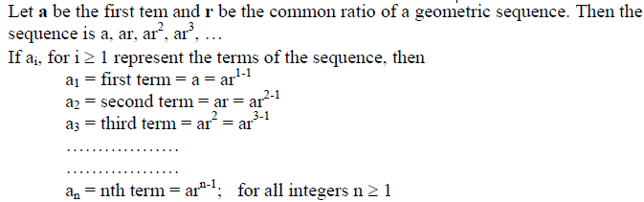
GENERAL TERM OF A GEOMETRIC SEQUENCE:

Slide 20
Geometric Progression
Examples:
Let a = 1 and r = −1. Then:
Let a = 2 and r = 5. Then:
Let a = 6 and r = 1/3. Then:

Slide 21
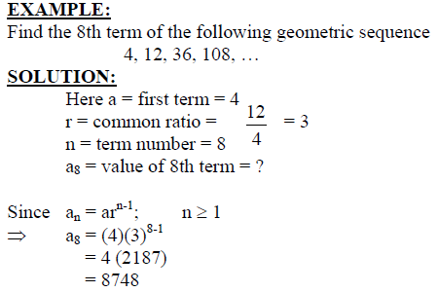
Geometric Sequence

Slide 22
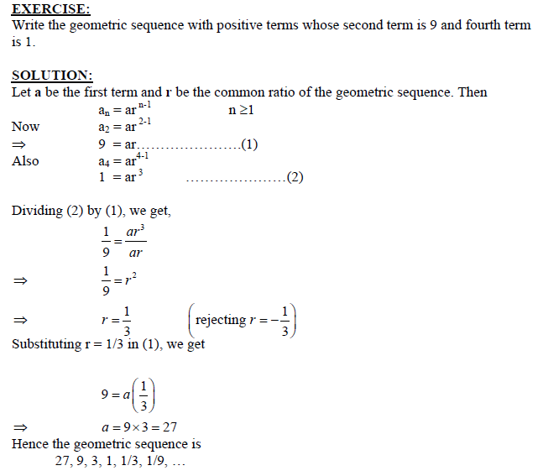
Geometric Sequence

Slide 23
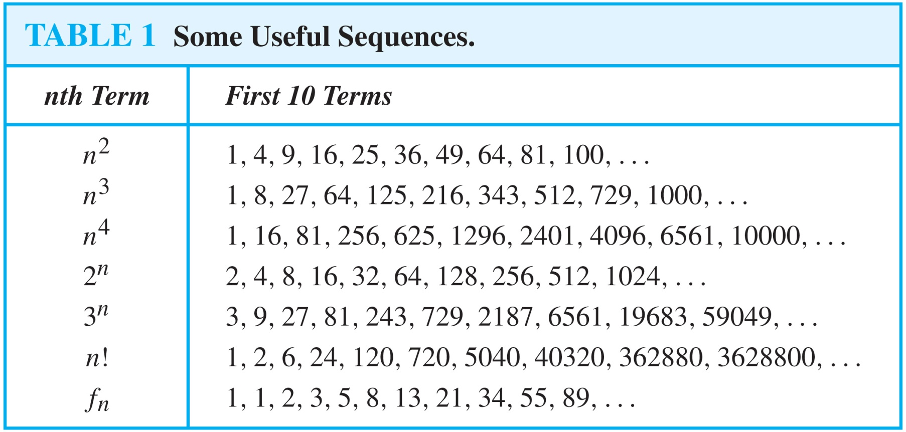
Useful Sequences

Slide 24
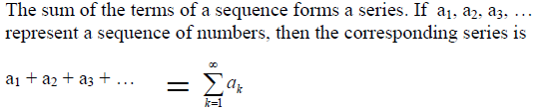
SERIES

Slide 25
SUMMATIONS

Slide 26
SUMMATIONS

Slide 27
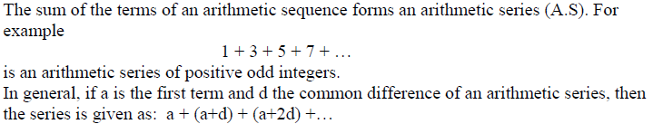
ARITHMETIC SERIES:

Slide 29
ARITHMETIC SERIES:

Slide 30
GEOMETRIC SERIES:

Slide 31
Strings
Definition: A string is a finite sequence of characters from a finite set (an alphabet).
Sequences of characters or bits are important in computer science.
The empty string is represented by λ.
The string abcde has length 5.

Slide 32
Recurrence Relations
Definition: A recurrence relation for the sequence {a_{n}} is an equation that expresses a_{n} in terms of one or more of the previous terms of the sequence, namely, a₀, a₁, …, a_{n-1}, for all integers n with n ≥ n₀, where n₀ is a nonnegative integer.
A sequence is called a solution of a recurrence relation if its terms satisfy the recurrence relation.
The initial conditions for a sequence specify the terms that precede the first term where the recurrence relation takes effect.

Slide 33
Questions about Recurrence Relations
Example 1: Let {a_{n}} be a sequence that satisfies the recurrence relation a_{n} = a_{n-1} + 3 for n = 1,2,3,4,…. and suppose that a₀ = 2. What are a₁ , a₂ and a₃?
[Here a₀ = 2 is the initial condition.]
Solution: We see from the recurrence relation that
a₁ = a₀ + 3 = 2 + 3 = 5
a₂ = 5 + 3 = 8
a₃ = 8 + 3 = 11

Slide 34
Questions about Recurrence Relations
Example 2: Let {a_{n}} be a sequence that satisfies the recurrence relation a_{n} = a_{n-1} – a_{n-2} for n = 2,3,4,…. and suppose that a₀ = 3 and a₁ = 5. What are a₂ and a₃?
[Here the initial conditions are a₀ = 3 and a₁ = 5. ]
Solution: We see from the recurrence relation that
a₂ = a₁ - a₀ = 5 – 3 = 2
a₃ = a₂ – a₁ = 2 – 5 = –3

Slide 35
Solving Recurrence Relations
Finding a formula for the nth term of the sequence generated by a recurrence relation is called solving the recurrence relation.
Such a formula is called a closed formula.
Various methods for solving recurrence relations will be covered in Chapter 8 where recurrence relations will be studied in greater depth.
Here we illustrate by example the method of iteration in which we need to guess the formula. The guess can be proved correct by the method of induction (Chapter 5).

Slide 36
Fibonacci Sequence
Definition: Define the Fibonacci sequence, f₀ ,f₁ ,f₂,…, by:
Initial Conditions: f₀ = 0, f₁ = 1
Recurrence Relation: f_{n} = f_{n-1} + f_{n-2}
Example: Find f₂ ,f₃ ,f₄ , f₅ and f₆ .
Answer:
f₂ = f₁ + f₀ = 1 + 0 = 1,
f₃ = f₂ + f₁ = 1 + 1 = 2,
f₄ = f₃ + f₂ = 2 + 1 = 3,
f₅ = f₄ + f₃ = 3 + 2 = 5,
f₆ = f₅ + f₄ = 5 + 3 = 8.

Slide 37
Iterative Solution Example
Method 1: Working upward, forward substitution
Let {a_{n}} be a sequence that satisfies the recurrence relation a_{n} = a_{n-1} + 3 for n = 2,3,4,…. and suppose that a₁ = 2.
a₂ = 2 + 3
a₃ = (2 + 3) + 3 = 2 + 3 ∙ 2
a₄ = (2 + 2 ∙ 3) + 3 = 2 + 3 ∙ 3
.
.
.
a_{n} = a_{n-1} + 3 = (2 + 3 ∙ (n – 2)) + 3 = 2 + 3(n – 1)

Slide 38
Iterative Solution Example
Method 2: Working downward, backward substitution
Let {a_{n}} be a sequence that satisfies the recurrence relation a_{n} = a_{n-1} + 3 for n = 2,3,4,…. and suppose that a₁ = 2.
a_{n} = a_{n-1} + 3
= (a_{n-2} + 3) + 3 = a_{n-2} + 3 ∙ 2
= (a_{n-3} + 3 )+ 3 ∙ 2 = a_{n-3} + 3 ∙ 3
.
.
.
= a₂ + 3(n – 2) = (a₁ + 3) + 3(n – 2) = 2 + 3(n – 1)

Slide 39
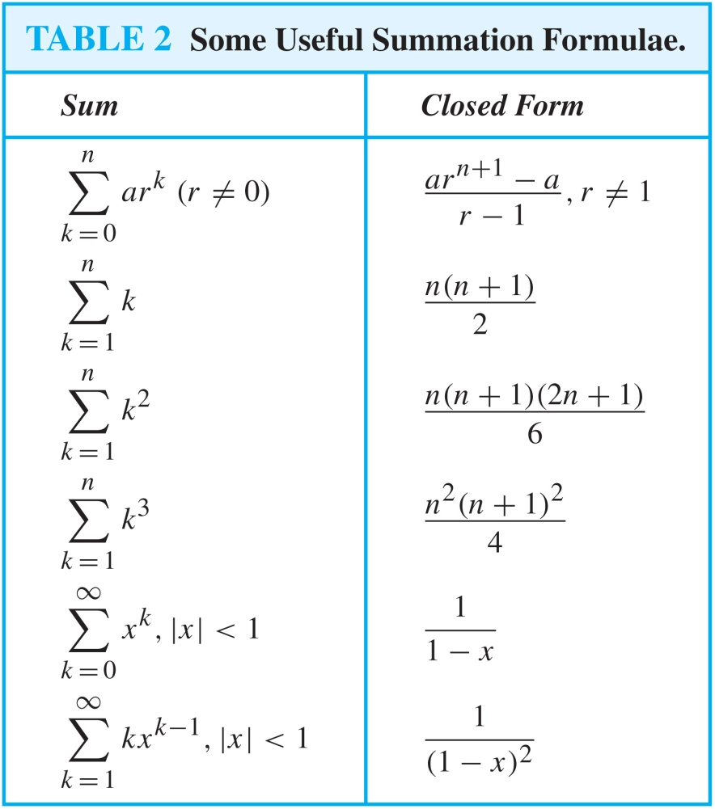
Some Useful Summation Formulae
Geometric Series: We just proved this.
Later we will prove some of these by induction.
Proof in text
(requires calculus)

Slide 40
Relations
Chapter 9
Mr. SHOAIB RAZA

Slide 41
Chapter Summary
Relations and Their Properties
Representing Relations
Equivalence Relations
Partial Orderings

Slide 42
Relations and Their Properties
Section 9.1

Slide 43
Section Summary
Relations and Functions
Properties of Relations
Reflexive Relations
Symmetric Relations
Antisymmetric Relations
Transitive Relations
Irreflexive Relations
Asymmetric Relations
Combining Relations

Slide 44
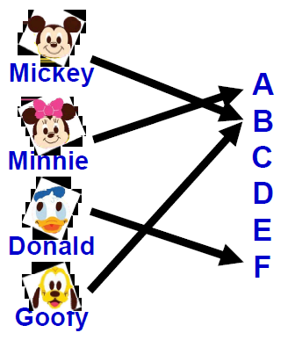
Recall, Function is…
Let A and B be nonempty sets Function f from A to B is an assignment of exactly one element of B to each element of A.
By defining using a relation, a function from A to B contains unique ordered pair (a, b) for every element a ∈ A.

Slide 45
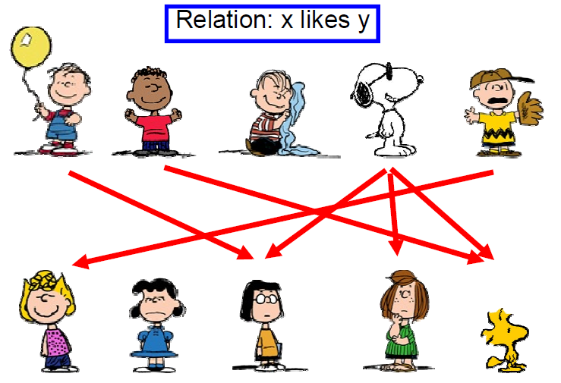
What is Relation?

Slide 46

Binary Relations
Definition: A binary relation R from a set A to a set B is a subset R ⊆ A × B.
Recall, for example:
A = {a1, a2} and B = {b1, b2, b3}
A x B = { (a1, b1), (a1, b2), (a1, b3),
(a2, b1), (a2, b2), (a2, b3)}
Ordered pairs, which
First element comes from A
Second element comes from B
aRb: (a, b) ∈ R
: (a, b) ∉ R
Moreover, when (a, b) belongs to R, a is said to be related to b by R.

Slide 47
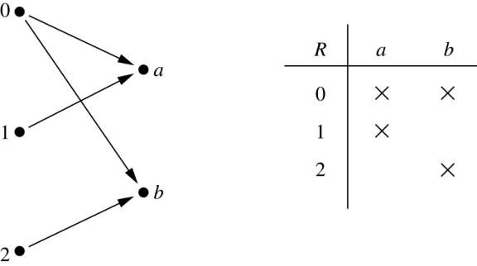
Binary Relations
Example:
Let A = {0,1,2} and B = {a,b}
{(0, a), (0, b), (1,a) , (2, b)} is a relation from A to B.
We can represent relations from a set A to a set B graphically or using a table:

Slide 48
Binary Relations
EXAMPLE:
Let A = {eggs, milk, corn} and B = {cows, goats, hens}
Define a relation R from A to B by (a, b) ∈R iff a is produced by b.
Then R = {(eggs, hens), (milk, cows), (milk, goats)}
Thus, with respect to this relation eggs R hens , milk R cows, etc.

Slide 49
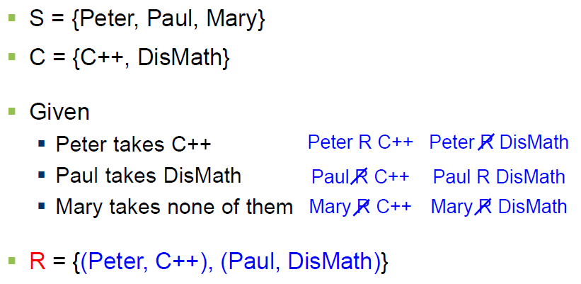
Binary Relations
EXAMPLE #1:

Slide 50
Domain and Range of a Relation
DOMAIN OF A RELATION:
The domain of a relation R from A to B is the set of all first elements of the ordered pairs which belong to R denoted by Dom(R).
Symbolically, Dom (R) = {a ∈A | (a, b) ∈R}
RANGE OF A RELATION:
The range of a relation R from A to B is the set of all second elements of the ordered pairs which belong to R denoted Ran(R).
Symbolically, Ran(R) = {b ∈B | (a, b) ∈ R}

Slide 51
Domain and Range of a Relation
EXERCISE:
Let A = {1, 2}, B = {1, 2, 3},
Define a binary relation R from A to B as follows:
R = {(a, b) ∈A × B | a < b} Then
a. Find the ordered pairs in R.
b. Find the Domain and Range of R.
c. Is 1R3, 2R2?
SOLUTION:
Given A = {1, 2}, B = {1, 2, 3},
A × B = {(1,1), (1,2), (1,3), (2,1), (2,2), (2,3)}
a. R = {(a, b) ∈A × B | a < b}
R = {(1,2), (1,3), (2,3)}

Slide 52
Domain and Range of a Relation
Given A = {1, 2}, B = {1, 2, 3},
A × B = {(1,1), (1,2), (1,3), (2,1), (2,2), (2,3)}
b. Find the Domain and Range of R.
Solution:
Dom(R) = {1,2} and Ran(R) = {2, 3}
c. Is 1R3, 2R2?
Solution:
c. Since (1, 3)∈R so 1R3.
Since (2, 2)∈R so 2R2.

Slide 53
Representing Relations

Slide 54
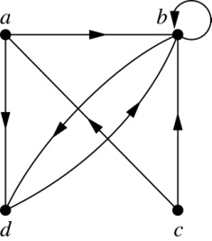
Representing Relations Using Digraphs
Definition: A directed graph, or digraph, consists of a set V of vertices (or nodes) together with a set E of ordered pairs of elements of V called edges (or arcs). The vertex a is called the initial vertex of the edge (a,b), and the vertex b is called the terminal vertex of this edge.
An edge of the form (a,a) is called a loop.
Example: A drawing of the directed graph with vertices a, b, c, and d, and edges (a, b), (a, d), (b, b), (b, d), (c, a), (c, b), and (d, b) is shown here.

Slide 55
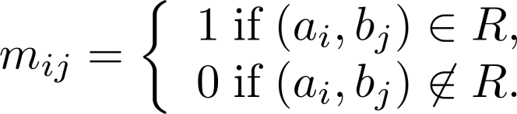
Representing Relations Using Matrices
A relation between finite sets can be represented using a zero-one matrix.
Suppose R is a relation from A = {a₁, a₂, …, a_{m}} to B = {b₁, b₂, …, b_{n}}.
The elements of the two sets can be listed in any particular arbitrary order. When A = B, we use the same ordering.
The relation R is represented by the matrix M_{R} = [m_{ij}], where
The matrix representing R has a 1 as its (i,j) entry when a_{i} is related to b_{j} and a 0 if a_{i} is not related to b_{j}.

Slide 56
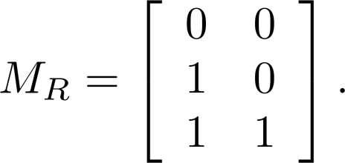
Examples of Representing Relations Using Matrices
Example 1: Suppose that A = {1,2,3} and B = {1,2}. Let R be the relation from A to B containing (a,b) if a ∈ A, b ∈ B, and a > b. What is the matrix representing R (assuming the ordering of elements is the same as the increasing numerical order)?
Solution: Because R = {(2,1), (3,1),(3,2)}, the matrix is

Slide 57
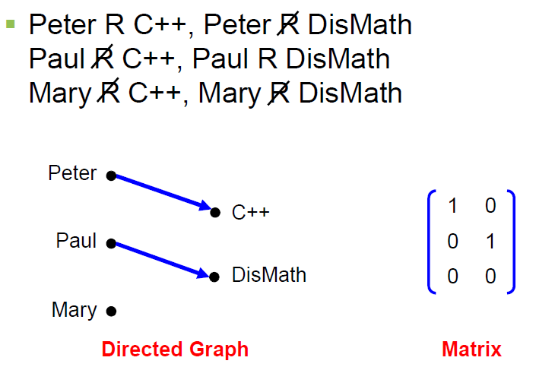
Binary Relations
EXAMPLE #1: (cont.)

Slide 58
Binary Relation on a Set
Definition: A binary relation R on a set A is a subset of A × A or a relation from A to A.
Example:
Suppose that A = {a,b,c}. Then R = {(a,a),(a,b), (a,c)} is a relation on A.
Let A = {1, 2, 3, 4}. The ordered pairs in the relation R = {(a,b) | a divides b} are
{(1,1), (1, 2), (1,3), (1, 4), (2, 2), (2, 4), (3, 3), and (4, 4)}.
REMARK:
For any set A
1. A × A is known as the universal relation.
2. ∅ is known as the empty relation.

Slide 59
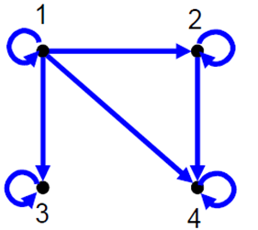
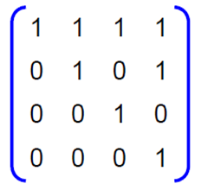
Binary Relation on a Set

Slide 60
Relations and Their Properties

Slide 61
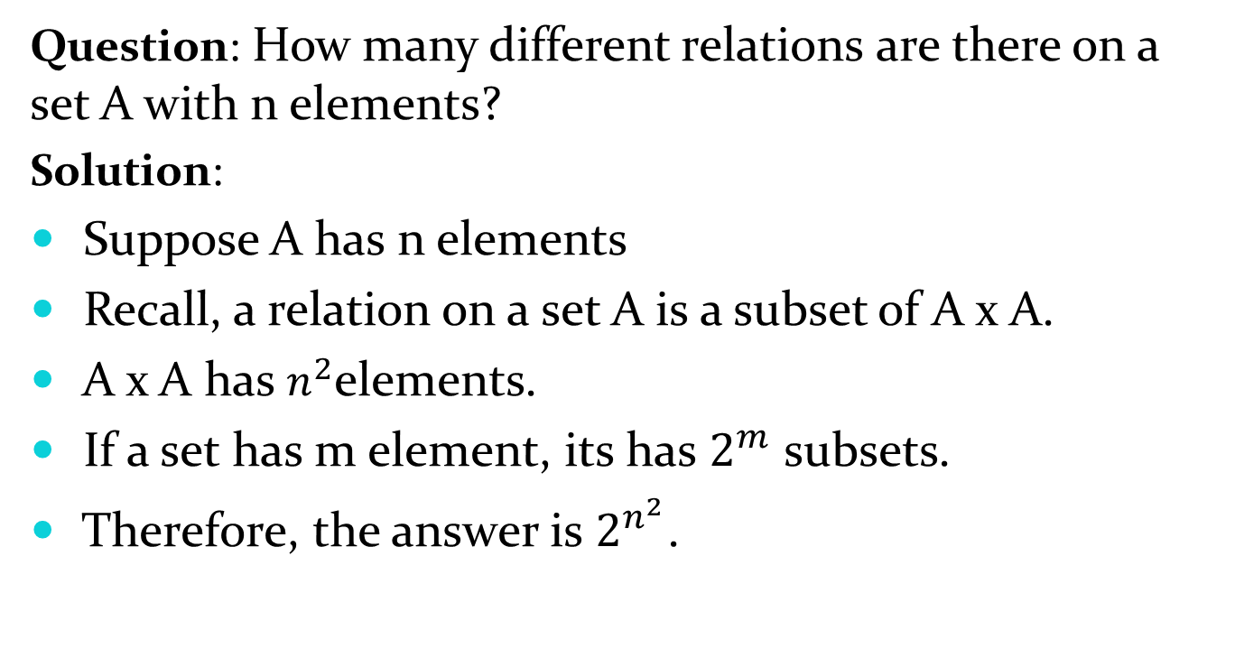
Binary Relation on a Set (cont.)
Question: How many different relations are there on a set A with n elements?
Solution:
Suppose A has n elements
Recall, a relation on a set A is a subset of A x A.
A x A has $n^{2}$elements.
If a set has m element, its has $2^{m}$ subsets.
Therefore, the answer is $2^{n^{2}}$.

Slide 62
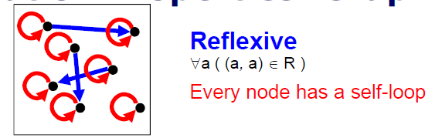
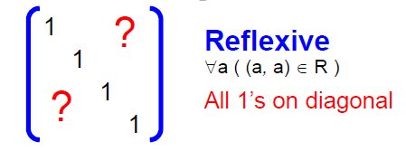
Reflexive Relations
Definition: R is reflexive iff (a,a) ∊ R for every element a ∊ A. Written symbolically, R is reflexive if and only if
∀a[a∊U ⟶ (a,a) ∊ R]
If A = ∅ then the empty relation is reflexive vacuously. That is the empty relation on an empty set is reflexive!

Slide 63
Reflexive Relations
EXAMPLE: Let A = {1, 2, 3, 4} and determine whether relations R1, R2, R3, and R4 are Reflexive?
R1 = {(1, 1), (3, 3), (2, 2), (4, 4)}
R2 = {(1, 1), (1, 4), (2, 2), (3, 3), (4, 3)}
R3 = {(1, 1), (1, 2), (2, 1), (2, 2), (3, 3), (4, 4)}
R4 = {(1, 3), (2, 2), (2, 4), (3, 1), (4, 4)}
Solution:
R1 is reflexive, since (a, a) ∈R1 for all a ∈A.
R2 is not reflexive, because (4, 4) ∉R2.
R3 is reflexive, since (a, a) ∈R3 for all a ∈A.
R4 is not reflexive, because (1, 1) ∉R4, (3, 3) ∉R4.

Slide 64
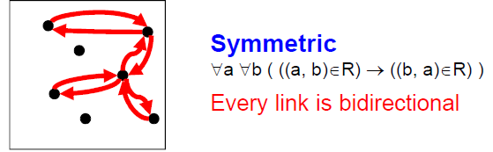
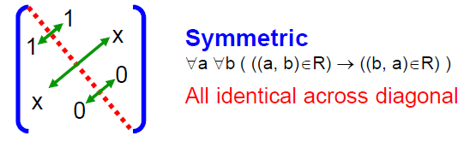
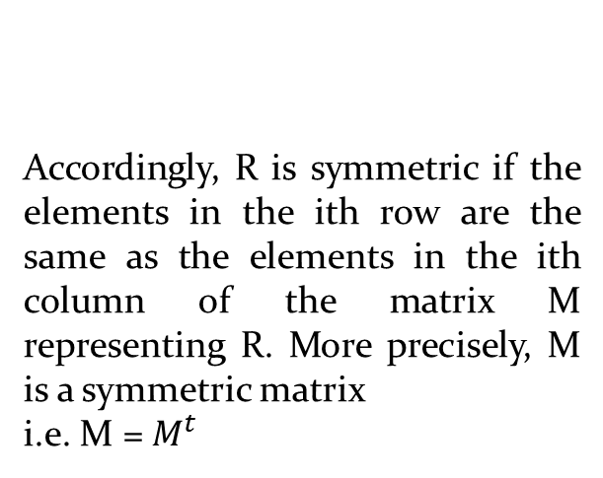
Symmetric Relations
Definition: R is symmetric iff (b,a) ∊ R whenever (a,b) ∊ R for all a,b ∊ A. Written symbolically, R is symmetric if and only if
∀a∀b [(a,b) ∊R ⟶ (b,a) ∊ R]
More precisely, M is a
symmetric matrix i.e. M = Mt
Accordingly, R is symmetric if the elements in the ith row are the same as the elements in the ith column of the matrix M representing R. More precisely, M is a symmetric matrix
i.e. M = $M^{t}$

Slide 65
Symmetric Relations
EXAMPLE: Let A = {1, 2, 3, 4} and determine whether relations R1, R2, R3, and R4 are Symmetric?
R1 = {(1, 1), (1, 3), (2, 4), (3, 1), (4,2)}
R2 = {(1, 1), (2, 2), (3, 3), (4, 4)}
R3 = {(2, 2), (2, 3), (3, 4)}
R4 = {(1, 1), (2, 2), (3, 3), (4, 3), (4, 4)}
Solution:
R1 is Symmetric, since (a, b) and (b, a) ∈R1 for all (a, b) ∈A.
R2 is also symmetric. We say it is vacuously true.
R3 is not symmetric, because (2,3) ∈ R3 but (3,2) ∉ R3.
R4 is not symmetric because (4,3) ∈ R4 but (3,4) ∉ R4.

Slide 66
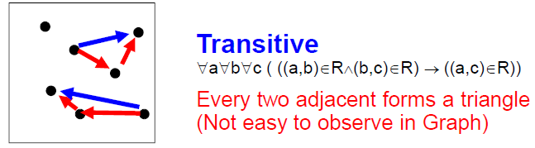
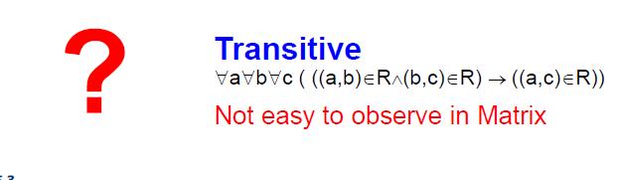
Transitive Relations
Definition: A relation R on a set A is called transitive if whenever (a,b) ∊ R and (b,c) ∊ R, then (a,c) ∊ R, for all a,b,c ∊ A. Written symbolically, R is transitive if and only if
∀a∀b ∀c[(a,b) ∊R ∧ (b,c) ∊ R ⟶ (a,c) ∊ R ]
For a transitive directed graph, whenever there is an arrow going from one point
to the second, and from the second to the third, there is an arrow going directly from the
first to the third.

Slide 67
Transitive Relations
EXAMPLE: Let A = {1, 2, 3, 4} and determine whether relations R1, R2 and R3 are Transitive?
R1 = {(1, 1), (1, 2), (1, 3), (2, 3)}
R2 = {(1, 2), (1, 4), (2, 3), (3, 4)}
R3 = {(2, 1), (2, 4), (2, 3), (3,4)}
Solution:
R1 is transitive because (1, 1), (1, 2) are in R, then to be transitive relation(1,2) must be there and it belongs to R.
R2 is not transitive since (1,2) and (2,3) ∈ R2 but (1,3) ∉ R2.
R3 is transitive.(check by definition)

Slide 68
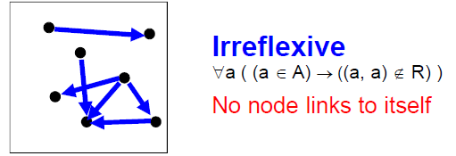
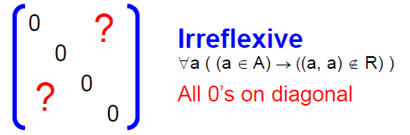
Irreflexive Relations
Definition: R is irreflexive iff for all a∈A,(a,a) ∉R. That is, R is irreflexive if no element in A is related to itself by R.
Written symbolically, R is irreflexive if and only if
∀a [(a ∊A) ⟶ (a , a)∉ R]
R is not irreflexive iff there is an element a∈A such that (a,a) ∈R.

Slide 69
Irreflexive Relations
EXAMPLE: Let A = {1, 2, 3, 4} and determine whether relations R1, R2 and R3 are Irreflexive?
R1 = {(1,3), (1,4), (2,3), (2,4), (3,1), (3,4)}
R2 = {(1,1), (1,2), (2,1), (2,2), (3,3), (4,4)}
R3= {(1,2), (2,3), (3,3), (3,4)}
Solution:
R1 is irreflexive since no element of A is related to itself in R1. i.e. (1,1)∉ R1, (2,2) ∉ R1, (3,3) ∉ R1,(4,4) ∉ R1.
R2 is not irreflexive, since all elements of A are related to themselves in R2.
R3 is not irreflexive since (3,3) ∈R3. Note that R3 is not reflexive.

Slide 70
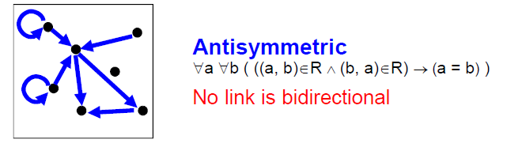
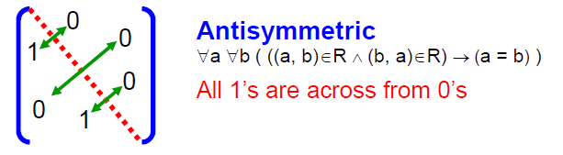
Antisymmetric Relations
Definition: A relation R on a set A such that for all a,b ∊ A if (a,b) ∊ R and (b,a) ∊ R, then a = b is called antisymmetric. Written symbolically, R is antisymmetric if and only if ∀a∀b [(a,b) ∊R ∧ (b,a) ∊ R ⟶ a = b]
Note: (a,a) may be an element in R.
Let R be an anti-symmetric relation on a set A = {a1, a2, …, an}. Then if (ai, aj) ∈R for
i ≠ j then (ai, aj) ∉R.
Thus in the matrix representation of R there is a 1 in the ith row and jth column
iff the jth row and ith column contains 0 vice versa.

Slide 71
Antisymmetric Relations
EXAMPLE: Let A = {1, 2, 3, 4} and determine whether relations R1, R2, R3, and R4 are Antisymmetric?
R1 = {(1,1),(2,2),(3,3)}
R2 = {(1,2),(2,2), (2,3), (3,4), (4,1)}
R3={(1,3),(2,2), (2,4), (3,1), (4,2)}
R4={(1,3),(2,4), (3,1), (4,3)}
Solution:
R1 is anti-symmetric and symmetric.
R2 is anti-symmetric but not symmetric because (1,2) ∈ R2 but (2,1) ∉ R2.
R3 is not anti-symmetric since (1,3) & (3,1) ∈ R3 but 1 ≠ 3. Note that R3 is symmetric.
R4 is neither anti-symmetric because (1,3) & (3,1) ∈ R4 but 1 ≠ 3 nor symmetric because (2,4) ∈ R4 but (4,2) ∉R4.

Slide 72
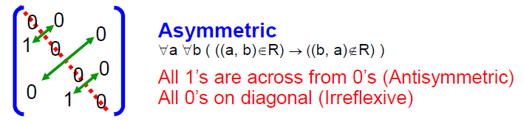
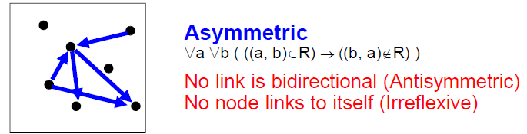
Asymmetric Relations
Definition: R is Asymmetric iff for all (a,b) ∊R than (b ,a)∉R. Written symbolically, R is Asymmetric if and only if
∀a ∀b[((a,b) ∊R)) ⟶ ((b , a)∉ R)]
Note:(a,a) cannot be an element in R.
Asymmetry = Antisymmetry + Irreflexivity

Slide 73
Asymmetric Relations
EXAMPLE: Let A = {1, 2, 3, 4} and determine whether relations R1, R2 and R3 are Asymmetric?
R1 = {(1,1), (1,2), (2,1), (2,2), (3,4), (4,1), (4,4)}
R2 = {(1,2),(2,3),(3,4)}
R3 = {(2,3),(3,3),(3,4)}
Solution:
R1 is not Asymmetric since R1 is neither Antisymmetric nor Irreflexive.
R2 is Asymmetric since R2 is both Antisymmetric and Irreflexive.
R3 is not Asymmetric since it is Antisymmetric but not irreflexive.

Slide 74

Activity Time

Slide 75
Consider the following relations on {1, 2, 3, 4}:
R1 = {(1, 1), (1, 2), (2, 1), (2, 2), (3, 4), (4, 1), (4, 4)},
R2 = {(1, 1), (1, 2), (2, 1)},
R3 = {(1, 1), (1, 2), (1, 4), (2, 1), (2, 2), (3, 3), (4, 1), (4, 4)},
R4 = {(2, 1), (3, 1), (3, 2), (4, 1), (4, 2), (4, 3)},
R5 = {(1, 1), (1, 2), (1, 3), (1, 4), (2, 2), (2, 3), (2, 4), (3, 3), (3, 4), (4, 4)},
R6 = {(3, 4)}.
Determine which of these relation are Reflexive, Symmetric, Transitive, Antisymmetric, Irreflexive and Asymmetric.

Slide 76
Combining Relations
As R is a subsets of A x B, the set operations can be applied
Union (U)
Intersection (∩)
Difference (-)
Symmetric Complement (⊕)
Given two relations R₁ and R₂, we can combine them using basic set operations to form new relations such as R₁ ∪ R₂, R₁ ∩ R₂, R₁ − R₂, R₂ − R₁ and R₁ ⊕ R₂.

Slide 77
Combining Relations
Given, A = {1,2,3}, B = {1,2,3,4}
R1 = {(1,1),(2,2),(3,3)},
R2 = {(1,1),(1,2),(1,3),(1,4)}
R1 U R2 = {(1,1),(1,2),(1,3),(1,4),(2,2),(3,3)}
R1 ∩ R2 = {(1,1)}
R1 - R2 = {(2,2),(3,3)}
R2 - R1 = {(1,2),(1,3),(1,4)}
R1 ⊕ R2 = {(1,2),(1,3),(1,4),(2,2),(3,3)}

Slide 78
Composition of Relations
Definition: Suppose
R₁ is a relation from a set A to a set B.
R₂ is a relation from B to a set C.
Then the composition (or composite) of R₂ with R₁, is a relation from A to C where
if (x,y) is a member of R₁ and (y,z) is a member of R₂, then (x,z) is a member of R₂∘ R₁.

Slide 79
Representing the Composition of a Relation
R₁
R₂
w
m
a
x
n
b
y
o
c
p
z
R₁∘ R₂ = {(b,D),(b,B)}

Slide 80
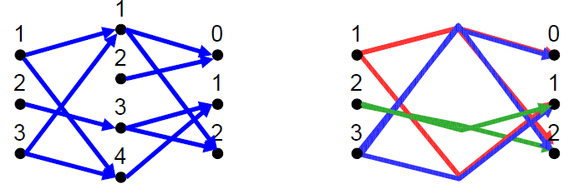
Composition of Relations
What is the composite of the relations R and S, where
R is the relation from {1,2,3} to {1,2,3,4} with
R = {(1,1),(1,4),(2,3),(3,1),(3,4)}
S is the relation from {1,2,3,4} to {0,1,2} with
S = {(1,0),(1,2),(2,0),(3,1),(3,2),(4,1)}?
S o R = {(1,0),(1,2),(1,1), (2,2),((2,1), 3,0),(3,2),(3,1)}

Slide 81
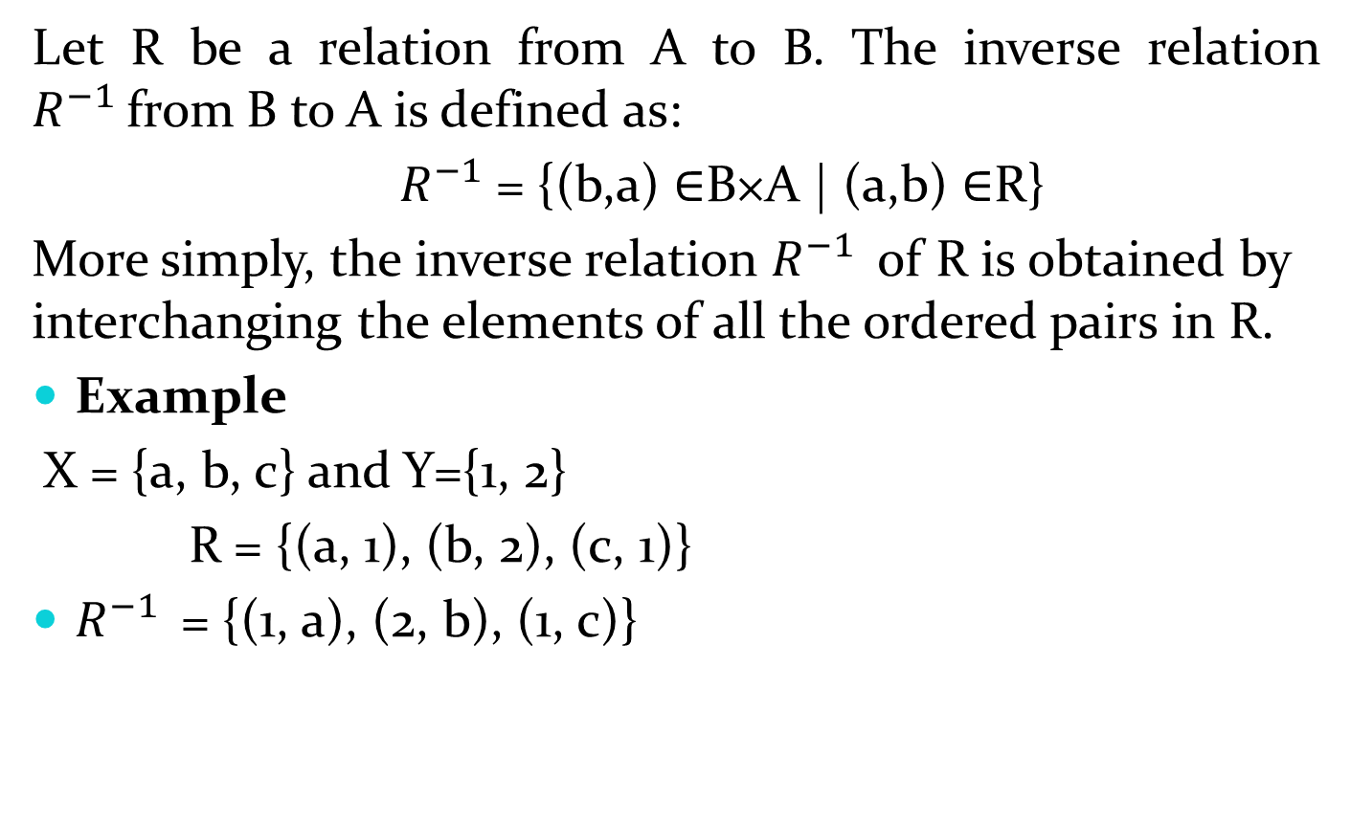
INVERSE OF A RELATION
Let R be a relation from A to B. The inverse relation $R^{−1 }$from B to A is defined as:
${ R}^{−1}$= {(b,a) ∈B×A | (a,b) ∈R}
More simply, the inverse relation $R^{−1 }$of R is obtained by interchanging the elements of all the ordered pairs in R.
Example
X = {a, b, c} and Y={1, 2}
R = {(a, 1), (b, 2), (c, 1)}
$R^{−1 }$= {(1, a), (2, b), (1, c)}

Slide 82
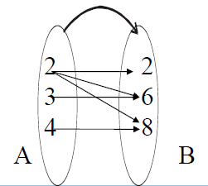
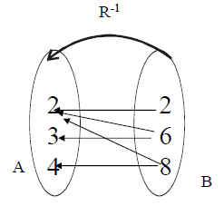
INVERSE OF A RELATION
The relation
R = {(2,2), (2,6), (2,8), (3,6), (4,8)} is represented by the arrow diagram.
Then inverse of the above relation can be obtained simply changing the directions of the arrows and hence the diagram is

Slide 83
Equivalence Relations

Slide 84
Equivalence Relations
Definition 1: A relation on a set A is called an equivalence relation if it is reflexive, symmetric, and transitive.
Definition 2: Two elements a, and b that are related by an equivalence relation are called equivalent. The notation a ∼ b is often used to denote that a and b are equivalent elements with respect to a particular equivalence relation.

Slide 85
Strings
Example:
Suppose that R is the relation on the set of strings of English letters such that aRb if and only if l(a) = l(b), where l(x) is the length of the string x. Is R an equivalence relation?
Solution: Show that all of the properties of an equivalence relation hold.
Reflexivity: Because l(a) = l(a), it follows that aRa for all strings a.
Symmetry: Suppose that aRb. Since l(a) = l(b), l(b) = l(a) also holds and bRa.
Transitivity: Suppose that aRb and bRc. Since l(a) = l(b), and l(b) = l(c), l(a) = l(a) also holds and aRc.

Slide 86
Congruence Modulo m
Example: Let m be an integer with m > 1. Show that the relation
R = {(a,b) | a ≡ b (mod m)}
is an equivalence relation on the set of integers.
Solution: Recall that a ≡ b (mod m) if and only if m divides a − b.
Reflexivity: a ≡ a (mod m) since a − a = 0 is divisible by m since 0 = 0 ∙ m.
Symmetry: Suppose that a ≡ b (mod m). Then a − b is divisible by m, and so a − b = km, where k is an integer. It follows that b − a = (− k) m, so b ≡ a (mod m).
Transitivity: Suppose that a ≡ b (mod m) and b ≡ c (mod m). Then m divides both a − b and b − c. Hence, there are integers k and l with a − b = km and b − c = lm. We obtain by adding the equations:
a − c = (a − b) + (b − c) = km + lm = (k + l) m.
Therefore, a ≡ c (mod m).

Slide 87
Divides
Example: Show that the “divides” relation on the set of positive integers is not an equivalence relation.
Solution: The properties of reflexivity, and transitivity do hold, but there relation is not transitive. Hence, “divides” is not an equivalence relation.
Reflexivity: a ∣ a for all a.
Not Symmetric: For example, 2 ∣ 4, but 4 ∤ 2. Hence, the relation is not symmetric.
Transitivity: Suppose that a divides b and b divides c. Then there are positive integers k and l such that b = ak and c = bl. Hence, c = a(kl), so a divides c. Therefore, the relation is transitive.

Slide 88
Partial Orderings

Slide 89
Partial Orderings
Definition 1: A relation R on a set S is called a partial ordering, or partial order, if it is reflexive, antisymmetric, and transitive.
A set together with a partial ordering R is called a partially ordered set, or poset, and is denoted by (S, R). Members of S are called elements of the poset.

Slide 90
Partial Orderings (continued)
Example 1: Show that the “greater than or equal” relation (≥) is a partial ordering on the set of integers.
Reflexivity: a ≥ a for every integer a.
Antisymmetry: If a ≥ b and b ≥ a , then a = b.
Transitivity: If a ≥ b and b ≥ c , then a ≥ c.
These properties all follow from the order axioms for the integers. (See Appendix 1).

Slide 91
Partial Orderings (continued)
Example 2: Show that the divisibility relation (∣) is a partial ordering on the set of integers.
Reflexivity: a ∣ a for all integers a. (see Example 9 in Section 9.1)
Antisymmetry: If a and b are positive integers with a | b and b | a, then a = b. (see Example 12 in Section 9.1)
Transitivity: Suppose that a divides b and b divides c. Then there are positive integers k and l such that b = ak and c = bl. Hence, c = a(kl), so a divides c. Therefore, the relation is transitive.
(Z⁺, ∣) is a poset.

Slide 92
Partial Orderings (continued)
Example 3: Show that the inclusion relation (⊆) is a partial ordering on the power set of a set S.
Reflexivity: A ⊆ A whenever A is a subset of S.
Antisymmetry: If A and B are positive integers with A ⊆ B and B ⊆ A, then A = B.
Transitivity: If A ⊆ B and B ⊆ C, then A ⊆ C.
The properties all follow from the definition of set inclusion.

Slide 93
Number Theory and Cryptography
Chapter 4

Slide 94
Chapter Motivation
Number theory is the part of mathematics devoted to the study of the integers and their properties.
Key ideas in number theory include divisibility and the primality of integers.
Number theory has long been studied because of the beauty of its ideas, its accessibility, and its wealth of open questions.
We’ll use many ideas developed in Chapter 1 about proof methods and proof strategy in our exploration of number theory.
Mathematicians have long considered number theory to be pure mathematics, but it has important applications to computer science and cryptography studied in Sections 4.5 and 4.6.

Slide 95
Chapter Summary
Divisibility and Modular Arithmetic
Primes and Greatest Common Divisors
Solving Congruencies
Applications of Congruencies
Cryptography

Slide 96
Divisibility and Modular Arithmetic
Section 4.1

Slide 97
Section Summary
Division
Division Algorithm
Modular Arithmetic

Slide 98
Division
Definition: If a and b are integers with a ≠ 0, then a divides b if there exists an integer c such that b = ac.
When a divides b we say that a is a factor or divisor of b and that b is a multiple of a.
The notation a | b denotes that a divides b.
If a | b, then b/a is an integer.
If a does not divide b, we write a ∤ b.
Example: Determine whether 3 | 7 and whether 3 | 12.

Slide 99
Properties of Divisibility
Theorem 1: Let a, b, and c be integers, where a ≠0.
If a | b and a | c, then a | (b + c);
If a | b, then a | bc for all integers c;
If a | b and b | c, then a | c.
Proof: (i) Suppose a | b and a | c, then it follows that there are integers s and t with b = as and c = at. Hence,
b + c = as + at = a(s + t). Hence, a | (b + c)
(Exercises 3 and 4 ask for proofs of parts (ii) and (iii).) Corollary: If a, b, and c be integers, where a ≠0, such that a | b and a | c, then a | mb + nc whenever m and n are integers.
Can you show how it follows easily from from (ii) and (i) of Theorem 1?

Slide 100
Division Algorithm
When an integer is divided by a positive integer, there is a quotient and a remainder. This is traditionally called the “Division Algorithm,” but is really a theorem.
Division Algorithm: If a is an integer and d a positive integer, then there are unique integers q and r, with 0 ≤ r < d, such that a = dq + r (proved in Section 5.2).
d is called the divisor.
a is called the dividend.
q is called the quotient.
r is called the remainder.
Examples:
What are the quotient and remainder when 101 is divided by 11?
Solution: The quotient when 101 is divided by 11 is 9 = 101 div 11, and the remainder is 2 = 101 mod 11.
What are the quotient and remainder when −11 is divided by 3?
Solution: The quotient when −11 is divided by 3 is −4 = −11 div 3, and the remainder is 1 = −11 mod 3.
Definitions of Functions div and mod
q = a div d
r = a mod d

Slide 101
Congruence Relation
Definition: If a and b are integers and m is a positive integer, then a is congruent to b modulo m if m divides a – b.
The notation a ≡ b (mod m) says that a is congruent to b modulo m.
We say that a ≡ b (mod m) is a congruence and that m is its modulus.
Two integers are congruent mod m if and only if they have the same remainder when divided by m.
If a is not congruent to b modulo m, we write
a ≢ b (mod m)
Example: Determine whether 17 is congruent to 5 modulo 6 and whether 24 and 14 are congruent modulo 6.
Solution:
17 ≡ 5 (mod 6) because 6 divides 17 − 5 = 12.
24 ≢ 14 (mod 6) since 6 divides 24 − 14 = 10 is not divisible by 6.

Slide 102
More on Congruences
Theorem 4: Let m be a positive integer. The integers a and b are congruent modulo m if and only if there is an integer k such that a = b + km.
Proof:
If a ≡ b (mod m), then (by the definition of congruence) m | a – b. Hence, there is an integer k such that a – b = km and equivalently a = b + km.
Conversely, if there is an integer k such that a = b + km, then km = a – b. Hence, m | a – b and a ≡ b (mod m).

Slide 103
The Relationship between (mod m) and mod m Notations
The use of “mod” in a ≡ b (mod m) and a mod m = b are different.
a ≡ b (mod m) is a relation on the set of integers.
In a mod m = b, the notation mod denotes a function.
The relationship between these notations is made clear in this theorem.
Theorem 3: Let a and b be integers, and let m be a positive integer. Then a ≡ b (mod m) if and only if a mod m = b mod m. (Proof in the exercises)

Slide 104
Congruencies of Sums and Products
Let m be a positive integer. If a ≡ b (mod m) and c ≡ d (mod m), then
a + c ≡ b + d (mod m) and ac ≡ bd (mod m)
Example: Because 7 ≡ 2 (mod 5) and 11 ≡ 1 (mod 5) , it follows from Theorem 5 that
18 = 7 + 11 ≡ 2 + 1 = 3 (mod 5)
77 = 7 11 ≡ 2 + 1 = 3 (mod 5)

Slide 105
Algebraic Manipulation of Congruencies
Multiplying both sides of a valid congruence by an integer preserves validity.
If a ≡ b (mod m) holds then c∙a ≡ c∙b (mod m), where c is any integer, holds by Theorem 5 with d = c.
Adding an integer to both sides of a valid congruence preserves validity.
If a ≡ b (mod m) holds then c + a ≡ c + b (mod m), where c is any integer, holds by Theorem 5 with d = c.
Dividing a congruence by an integer does not always produce a valid congruence.
Example: The congruence 14≡ 8 (mod 6) holds. But dividing both sides by 2 does not produce a valid congruence since 14/2 = 7 and 8/2 = 4, but 7≢4 (mod 6).

Slide 106
Computing the mod m Function of Products and Sums
We use the following corollary to Theorem 5 to compute the remainder of the product or sum of two integers when divided by m from the remainders when each is divided by m.
Corollary: Let m be a positive integer and let a and b be integers. Then
(a + b) (mod m) = ((a mod m) + (b mod m)) mod m
and
ab mod m = ((a mod m) (b mod m)) mod m.
(proof in text)

Slide 107
Applications of Congruences

Slide 108
Section Summary
Hashing Functions
Pseudorandom Numbers
Check Digits

Slide 109
Hashing Functions
Definition: A hashing function h assigns memory location h(k) to the record that has k as its key.
A common hashing function is h(k) = k mod m, where m is the number of memory locations.
Because this hashing function is onto, all memory locations are possible.
Example: Let h(k) = k mod 111. This hashing function assigns the records of customers with social security numbers as keys to memory locations in the following manner:
h(064212848) = 064212848 mod 111 = 14
h(037149212) = 037149212 mod 111 = 65
h(107405723) = 107405723 mod 111 = 14, but since location 14 is already occupied, the record is assigned to the next available position, which is 15.
The hashing function is not one-to-one as there are many more possible keys than memory locations. When more than one record is assigned to the same location, we say a collision occurs. Here a collision has been resolved by assigning the record to the first free location.
For collision resolution, we can use a linear probing function:
h(k,i) = (h(k) + i) mod m, where i runs from 0 to m − 1.
There are many other methods of handling with collisions. You may cover these in a
later CS course.

Slide 110
Pseudorandom Numbers
Randomly chosen numbers are needed for many purposes, including computer simulations.
Pseudorandom numbers are not truly random since they are generated by systematic methods.
The linear congruential method is one commonly used procedure for generating pseudorandom numbers.
Four integers are needed: the modulus m, the multiplier a, the increment c, and seed x₀, with 2 ≤ a < m, 0 ≤ c < m, 0 ≤ x₀ < m.
We generate a sequence of pseudorandom numbers {x_{n}}, with 0 ≤ x_{n} < m for all n, by successively using the recursively defined function
(an example of a recursive definition, discussed in Section 5.3)
If psudorandom numbers between 0 and 1 are needed, then the generated numbers are divided by the modulus, x_{n} /m.
x_{n+1} = (ax_{n} + c) mod m.

Slide 111
Pseudorandom Numbers
Example: Find the sequence of pseudorandom numbers generated by the linear congruential method with modulus m = 9, multiplier a = 7, increment c = 4, and seed x₀ = 3.
Solution: Compute the terms of the sequence by successively using the congruence x_{n+1} = (7x_{n} + 4) mod 9, with x₀ = 3.
x₁ = 7x₀ + 4 mod 9 = 7∙3 + 4 mod 9 = 25 mod 9 = 7,
x₂ = 7x₁ + 4 mod 9 = 7∙7 + 4 mod 9 = 53 mod 9 = 8,
x₃ = 7x₂ + 4 mod 9 = 7∙8 + 4 mod 9 = 60 mod 9 = 6,
x₄ = 7x₃ + 4 mod 9 = 7∙6 + 4 mod 9 = 46 mod 9 = 1,
x₅ = 7x₄ + 4 mod 9 = 7∙1 + 4 mod 9 = 11 mod 9 = 2,
x₆ = 7x₅ + 4 mod 9 = 7∙2 + 4 mod 9 = 18 mod 9 = 0,
x₇ = 7x₆ + 4 mod 9 = 7∙0 + 4 mod 9 = 4 mod 9 = 4,
x₈ = 7x₇ + 4 mod 9 = 7∙4 + 4 mod 9 = 32 mod 9 = 5,
x₉ = 7x₈ + 4 mod 9 = 7∙5 + 4 mod 9 = 39 mod 9 = 3.
The sequence generated is 3,7,8,6,1,2,0,4,5,3,7,8,6,1,2,0,4,5,3,…
It repeats after generating 9 terms.
Commonly, computers use a linear congruential generator with increment c = 0. This is called a pure multiplicative generator. Such a generator with modulus 2³¹ − 1 and multiplier 7⁵ = 16,807 generates 2³¹ − 2 numbers before repeating.

Slide 112
Check Digits: UPCs
A common method of detecting errors in strings of digits is to add an extra digit at the end, which is evaluated using a function. If the final digit is not correct, then the string is assumed not to be correct.
Example: Retail products are identified by their Universal Product Codes (UPCs). Usually these have 12 decimal digits, the last one being the check digit. The check digit is determined by the congruence:
3x₁ + x₂ + 3x₃ + x₄ + 3x₅ + x₆ + 3x₇ + x₈ + 3x₉ + x₁₀ + 3x₁₁ + x₁₂ ≡ 0 (mod 10).
Suppose that the first 11 digits of the UPC are 79357343104. What is the check digit?
Is 041331021641 a valid UPC?
Solution:
3∙7 + 9 + 3∙3 + 5 + 3∙7 + 3 + 3∙4 + 3 + 3∙1 + 0 + 3∙4 + x₁₂ ≡ 0 (mod 10)
21 + 9 + 9 + 5 + 21 + 3 + 12+ 3 + 3 + 0 + 12 + x₁₂ ≡ 0 (mod 10)
98 + x₁₂ ≡ 0 (mod 10)
x₁₂ ≡ 0 (mod 10) So, the check digit is 2.
3∙0 + 4 + 3∙1 + 3 + 3∙3 + 1 + 3∙0 + 2 + 3∙1 + 6 + 3∙4 + 1 ≡ 0 (mod 10)
0 + 4 + 3 + 3 + 9 + 1 + 0+ 2 + 3 + 6 + 12 + 1 = 44 ≡ 4 ≢ (mod 10)
Hence, 041331021641 is not a valid UPC.

Slide 113
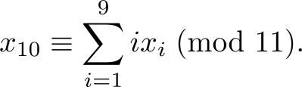
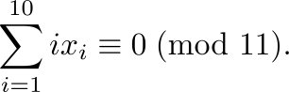
Check Digits:ISBNs
Books are identified by an International Standard Book Number (ISBN-10), a 10 digit code. The first 9 digits identify the language, the publisher, and the book. The tenth digit is a check digit, which is determined by the following congruence
The validity of an ISBN-10 number can be evaluated with the equivalent
Suppose that the first 9 digits of the ISBN-10 are 007288008. What is the check digit?
Is 084930149X a valid ISBN10?
Solution:
a. X₁₀ ≡ 1∙0 + 2∙0 + 3∙7 + 4∙2 + 5∙8 + 6∙8 + 7∙ 0 + 8∙0 + 9∙8 (mod 11).
X₁₀ ≡ 0 + 0 + 21 + 8 + 40 + 48 + 0 + 0 + 72 (mod 11).
X₁₀ ≡ 189 ≡ 2 (mod 11). Hence, X₁₀ = 2.
b. 1∙0 + 2∙8 + 3∙4 + 4∙9 + 5∙3 + 6∙0 + 7∙ 1 + 8∙4 + 9∙9 + 10∙10 =
0 + 16 + 12 + 36 + 15 + 0 + 7 + 32 + 81 + 100 = 299 ≡ 2 ≢ 0 (mod 11)
Hence, 084930149X is not a valid ISBN-10.
A single error is an error in one digit of an identification number and a transposition error is the accidental interchanging of two digits. Both of these kinds of errors can be detected by the check digit for ISBN-10. (see text for more details)
X is used for the digit 10.

Slide 114
Arithmetic Modulo m
Definitions: Let Z_{m} be the set of nonnegative integers less than m: {0,1, …., m−1}
The operation +_{m} is defined as a +_{m} b = (a + b) mod m. This is addition modulo m.
The operation ∙_{m} is defined as a ∙_{m} b = (a . b) mod m. This is multiplication modulo m.
Using these operations is said to be doing arithmetic modulo m.
Example: Find 7 +₁₁ 9 and 7 ∙₁₁ 9.
Solution: Using the definitions above:
7 +₁₁ 9 = (7 + 9) mod 11 = 16 mod 11 = 5
7 ∙₁₁ 9 = (7 ∙ 9) mod 11 = 63 mod 11 = 8

Slide 115
Arithmetic Modulo m
The operations +_{m} and ∙_{m} satisfy many of the same properties as ordinary addition and multiplication.
Closure: If a and b belong to Z_{m} , then a +_{m} b and a ∙_{m} b belong to Z_{m} .
Associativity: If a, b, and c belong to Z_{m} , then (a +_{m} b) +_{m} c = a +_{m} (b +_{m} c) and (a ∙_{m} b) ∙_{m} c = a ∙_{m} (b ∙_{m} c).
Commutativity: If a and b belong to Z_{m} , then a +_{m} b = b +_{m} a and a ∙_{m} b = b ∙_{m} a.
Identity elements: The elements 0 and 1 are identity elements for addition and multiplication modulo m, respectively.
If a belongs to Z_{m} , then a +_{m} 0 = a and a ∙_{m} 1 = a.
continued →

Slide 116
Arithmetic Modulo m
Additive inverses: If a≠ 0 belongs to Z_{m} , then m− a is the additive inverse of a modulo m and 0 is its own additive inverse.
a +_{m} (m− a ) = 0 and 0 +_{m} 0 = 0
Distributivity: If a, b, and c belong to Z_{m} , then
a ∙_{m} (b +_{m} c) = (a ∙_{m} b) +_{m} (a ∙_{m} c) and (a +_{m} b) ∙_{m} c = (a ∙_{m} c) +_{m} (b ∙_{m} c).
Exercises 42-44 ask for proofs of these properties.
Multiplicatative inverses have not been included since they do not always exist. For example, there is no multiplicative inverse of 2 modulo 6.
(optional) Using the terminology of abstract algebra, Z_{m} with +_{m} is a commutative group and Z_{m} with +_{m} and ∙_{m} is a commutative ring.

Slide 117
Primes and Greatest Common Divisors
Section 4.3

Slide 118
Section Summary
Prime Numbers and their Properties
Greatest Common Divisors and Least Common Multiples
The Euclidian Algorithm
gcds as Linear Combinations

Slide 119
Primes
Definition: A positive integer p greater than 1 is called prime if the only positive factors of p are 1 and p. A positive integer that is greater than 1 and is not prime is called composite.
Example: The integer 7 is prime because its only positive factors are 1 and 7, but 9 is composite because it is divisible by 3.

Slide 120
The Fundamental Theorem of Arithmetic
Theorem: Every positive integer greater than 1 can be written uniquely as a prime or as the product of two or more primes where the prime factors are written in order of non decreasing size.
Examples:
100 = 2 ∙ 2 ∙ 5 ∙ 5 = 2² ∙ 5²
641 = 641
999 = 3 ∙ 3 ∙ 3 ∙ 37 = 3³ ∙ 37
1024 = 2 ∙ 2 ∙ 2 ∙ 2 ∙ 2 ∙ 2 ∙ 2 ∙ 2 ∙ 2 ∙ 2 = 2¹⁰

Slide 121
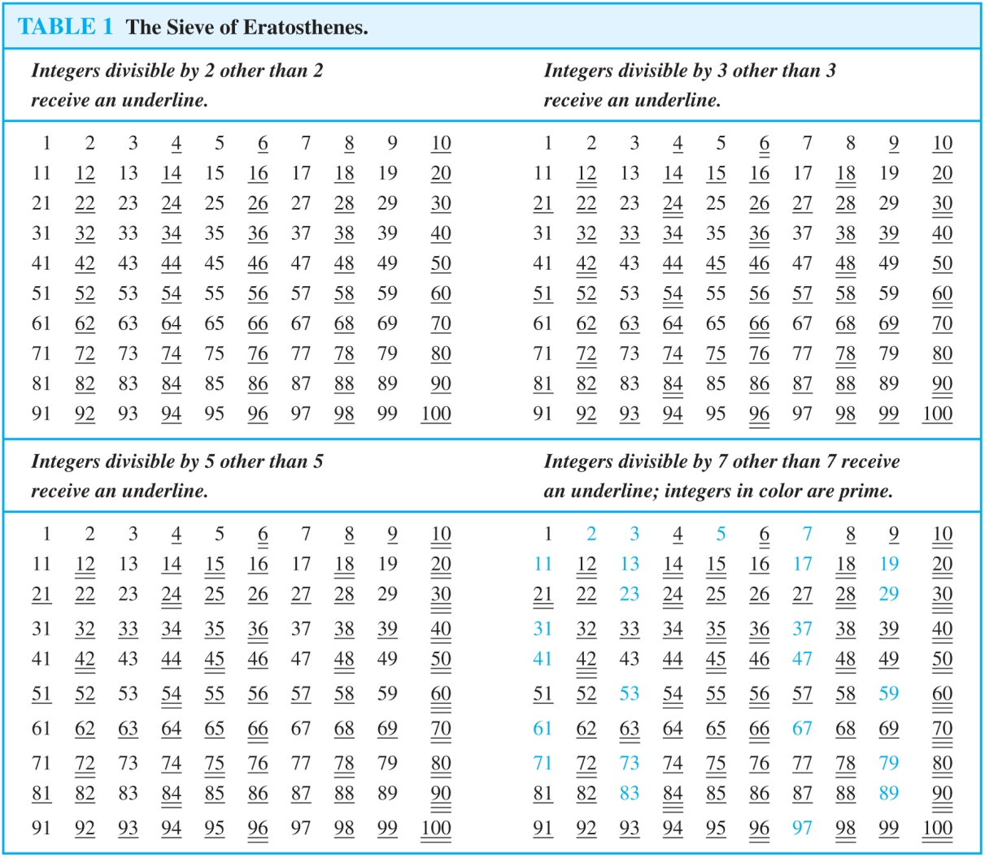
The Sieve of Erastosthenes
If an integer n is a composite integer, then it has a prime divisor less than or equal to √n.
To see this, note that if n = ab, then a ≤ √n or b ≤√n.
Trial division, a very inefficient method of determining if a number n is prime, is to try every integer i ≤√n and see if n is divisible by i.

Slide 122
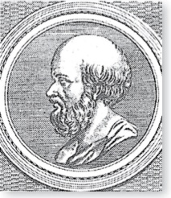
The Sieve of Erastosthenes
Erastothenes
(276-194 B.C.)
The Sieve of Erastosthenes can be used to find all primes not exceeding a specified positive integer. For example, begin with the list of integers between 1 and 100.
Delete all the integers, other than 2, divisible by 2.
Delete all the integers, other than 3, divisible by 3.
Next, delete all the integers, other than 5, divisible by 5.
Next, delete all the integers, other than 7, divisible by 7.
Since all the remaining integers are not divisible by any of the previous integers, other than 1, the primes are:
{2,3,5,7,11,13,17,19,23,29,31,37,41,43,47,53,59,61,67,71,73,79,83,89, 97}
continued →

Slide 123
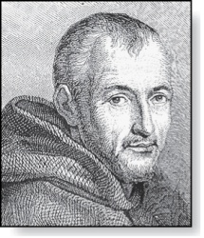
Mersenne Primes
Marin Mersenne
(1588-1648)
Definition: Prime numbers of the form 2^{p} − 1 , where p is prime, are called Mersenne primes.
2² − 1 = 3, 2³ − 1 = 7, 2⁵ − 1 = 37 , and 2⁷ − 1 = 127 are Mersenne primes.
2¹¹ − 1 = 2047 is not a Mersenne prime since 2047 = 23∙89.
There is an efficient test for determining if 2^{p} − 1 is prime.
The largest known prime numbers are Mersenne primes.
As of mid 2011, 47 Mersenne primes were known, the largest is 2^{43,112,609} − 1, which has nearly 13 million decimal digits.
The Great Internet Mersenne Prime Search (GIMPS) is a distributed computing project to search for new Mersenne Primes.
http://www.mersenne.org/

Slide 124
Greatest Common Divisor
Definition: Let a and b be integers, not both zero. The largest integer d such that d | a and also d | b is called the greatest common divisor of a and b. The greatest common divisor of a and b is denoted by gcd(a,b).
One can find greatest common divisors of small numbers by inspection.
Example: What is the greatest common divisor of 24 and 36?
Solution: gcd(24,36) = 12
Example: What is the greatest common divisor of 17 and 22?
Solution: gcd(17,22) = 1

Slide 125
Greatest Common Divisor
Definition: The integers a and b are relatively prime if their greatest common divisor is 1.
Example: 17 and 22
Definition: The integers a₁, a₂, …, a_{n} are pairwise relatively prime if gcd(a_{i}, a_{j})= 1 whenever 1 ≤ i<j ≤n.
Example: Determine whether the integers 10, 17 and 21 are pairwise relatively prime.
Solution: Because gcd(10,17) = 1, gcd(10,21) = 1, and gcd(17,21) = 1, 10, 17, and 21 are pairwise relatively prime.
Example: Determine whether the integers 10, 19, and 24 are pairwise relatively prime.
Solution: Because gcd(10,24) = 2, 10, 19, and 24 are not pairwise relatively prime.

Slide 126
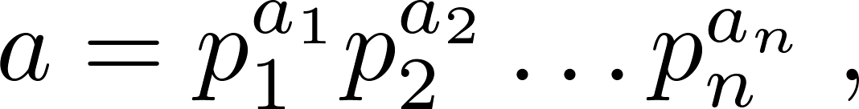

Finding the Greatest Common Divisor Using Prime Factorizations
Suppose the prime factorizations of a and b are:
where each exponent is a nonnegative integer, and where all primes occurring in either prime factorization are included in both. Then:
This formula is valid since the integer on the right (of the equals sign) divides both a and b. No larger integer can divide both a and b.
Example: 120 = 2³ ∙3 ∙5 500 = 2² ∙5³
gcd(120,500) = 2^{min(3,2)} ∙3^{min(1,0)} ∙5^{min(1,3)} = 2² ∙3⁰ ∙5¹ = 20
Finding the gcd of two positive integers using their prime factorizations is not efficient because there is no efficient algorithm for finding the prime factorization of a positive integer.

Slide 127
Least Common Multiple
Definition: The least common multiple of the positive integers a and b is the smallest positive integer that is divisible by both a and b. It is denoted by lcm(a,b).
The least common multiple can also be computed from the prime factorizations.
This number is divided by both a and b and no smaller number is divided by a and b.
Example: lcm(2³3⁵7², 2⁴3³) = 2^{max(3,4)} 3^{max(5,3)} 7^{max(2,0)} = 2⁴ 3⁵ 7²
The greatest common divisor and the least common multiple of two integers are related by:
Theorem 5: Let a and b be positive integers. Then
ab = gcd(a,b) ∙lcm(a,b)
(proof is Exercise 31)

Slide 128

Euclidean Algorithm
Euclid
(325 B.C.E. – 265 B.C.E.)
The Euclidian algorithm is an efficient method for computing the greatest common divisor of two integers. It is based on the idea that gcd(a,b) is equal to gcd(a,c) when a > b and c is the remainder when a is divided by b.
Example: Find gcd(91, 287):
287 = 91 ∙ 3 + 14
91 = 14 ∙ 6 + 7
14 = 7 ∙ 2 + 0
gcd(287, 91) = gcd(91, 14) = gcd(14, 7) = 7
Divide 287 by 91
Divide 91 by 14
Divide 14 by 7
Stopping condition
continued →

Slide 129
Euclidean Algorithm
The Euclidean algorithm expressed in pseudocode is:
In Section 5.3, we’ll see that the time complexity of the algorithm is O(log b), where a > b.
procedure gcd(a, b: positive integers)
x := a
x := b
while y ≠ 0
r := x mod y
x := y
y := r
return x {gcd(a,b) is x}

Slide 130

gcds as Linear Combinations
Étienne Bézout
(1730-1783)
Bézout’s Theorem: If a and b are positive integers, then there exist integers s and t such that gcd(a,b) = sa + tb.
Definition: If a and b are positive integers, then integers s and t such that gcd(a,b) = sa + tb are called Bézout coefficients of a and b. The equation gcd(a,b) = sa + tb is called Bézout’s identity.
By Bézout’s Theorem, the gcd of integers a and b can be expressed in the form sa + tb where s and t are integers. This is a linear combination with integer coefficients of a and b.
gcd(6,14) = (−2)∙6 + 1∙14

Slide 131
Finding gcds as Linear Combinations
Example: Express gcd(252,198) = 18 as a linear combination of 252 and 198.
Solution: First use the Euclidean algorithm to show gcd(252,198) = 18
252 = 1∙198 + 54
198 = 3 ∙54 + 36
54 = 1 ∙36 + 18
36 = 2 ∙18
Now working backwards, from iii and i above
18 = 54 − 1 ∙36
36 = 198 − 3 ∙54
Substituting the 2nd equation into the 1st yields:
18 = 54 − 1 ∙(198 − 3 ∙54 )= 4 ∙54 − 1 ∙198
Substituting 54 = 252 − 1 ∙198 (from i)) yields:
18 = 4 ∙(252 − 1 ∙198) − 1 ∙198 = 4 ∙252 − 5 ∙198
This method illustrated above is a two pass method. It first uses the Euclidian algorithm to find the gcd and then works backwards to express the gcd as a linear combination of the original two integers. A one pass method, called the extended Euclidean algorithm, is developed in the exercises.

Slide 132
Dividing Congruencies by an Integer
Dividing both sides of a valid congruence by an integer does not always produce a valid congruence (see Section 4.1).
But dividing by an integer relatively prime to the modulus does produce a valid congruence:
Theorem 7: Let m be a positive integer and let a, b, and c be integers. If ac ≡ bc (mod m) and gcd(c,m) = 1, then a ≡ b (mod m).
Proof: Since ac ≡ bc (mod m), m | ac − bc = c(a − b) by Lemma 2 and the fact that gcd(c,m) = 1, it follows that m | a − b. Hence, a ≡ b (mod m).

Slide 133
Solving Congruencies
Section 4.4

Slide 134
Section Summary
Linear Congruencies
The Chinese Remainder Theorem
Fermat’s Little Theorem
Pseudo primes

Slide 135
Linear Congruencies
Definition: A congruence of the form
ax ≡ b( mod m),
where m is a positive integer, a and b are integers, and x is a variable, is called a linear congruence.
The solutions to a linear congruence ax≡ b( mod m) are all integers x that satisfy the congruence.
Definition: An integer ā such that āa ≡ 1( mod m) is said to be an inverse of a modulo m.
Example: 5 is an inverse of 3 modulo 7 since 5∙3 = 15 ≡ 1(mod 7)
One method of solving linear congruencies makes use of an inverse ā, if it exists. Although we can not divide both sides of the congruence by a, we can multiply by ā to solve for x.

Slide 136
Inverse of a modulo m
The following theorem guarantees that an inverse of a modulo m exists whenever a and m are relatively prime. Two integers a and b are relatively prime when gcd(a,b) = 1.
Theorem 1: If a and m are relatively prime integers and m > 1, then an inverse of a modulo m exists. Furthermore, this inverse is unique modulo m. (This means that there is a unique positive integer ā less than m that is an inverse of a modulo m and every other inverse of a modulo m is congruent to ā modulo m.)
Proof: Since gcd(a,m) = 1, by Theorem 6 of Section 4.3, there are integers s and t such that sa + tm = 1.
Hence, sa + tm ≡ 1 ( mod m).
Since tm ≡ 0 ( mod m), it follows that sa ≡ 1 ( mod m)
Consequently, s is an inverse of a modulo m.
The uniqueness of the inverse is Exercise 7.

Slide 137
Finding Inverses
The Euclidean algorithm and Bézout coefficients gives us a systematic approaches to finding inverses.
Example: Find an inverse of 3 modulo 7.
Solution: Because gcd(3,7) = 1, by Theorem 1, an inverse of 3 modulo 7 exists.
Using the Euclidian algorithm: 7 = 2∙3 + 1.
From this equation, we get −2∙3 + 1∙7 = 1, and see that −2 and 1 are Bézout coefficients of 3 and 7.
Hence, −2 is an inverse of 3 modulo 7.
Also every integer congruent to −2 modulo 7 is an inverse of 3 modulo 7, i.e., 5, −9, 12, etc.

Slide 138
Finding Inverses
Example: Find an inverse of 101 modulo 4620.
Solution: First use the Euclidian algorithm to show that gcd(101,4620) = 1.
Working Backwards:
4620 = 45∙101 + 75
101 = 1∙75 + 26
75 = 2∙26 + 23
26 = 1∙23 + 3
23 = 7∙3 + 2
3 = 1∙2 + 1
2 = 2∙1
1 = 3 − 1∙2
1 = 3 − 1∙(23 − 7∙3) = − 1 ∙23 + 8∙3
1 = −1∙23 + 8∙(26 − 1∙23) = 8∙26 − 9 ∙23
1 = 8∙26 − 9 ∙(75 − 2∙26 )= 26∙26 − 9 ∙75
1 = 26∙(101 − 1∙75) − 9 ∙75
= 26∙101 − 35 ∙75
1 = 26∙101 − 35 ∙(42620 − 45∙101)
= − 35 ∙42620 + 1601∙101
Since the last nonzero
remainder is 1,
gcd(101,4260) = 1
Bézout coefficients : − 35 and 1601
1601 is an inverse of 101 modulo 42620

Slide 139
Using Inverses to Solve Congruences
We can solve the congruence ax≡ b( mod m) by multiplying both sides by ā.
Example: What are the solutions of the congruence 3x≡ 4( mod 7).
Solution: We found that −2 is an inverse of 3 modulo 7 (two slides back). We multiply both sides of the congruence by −2 giving
−2 ∙ 3x ≡ −2 ∙ 4(mod 7).
Because −6 ≡ 1 (mod 7) and −8 ≡ 6 (mod 7), it follows that if x is a solution, then x ≡ −8 ≡ 6 (mod 7)
We need to determine if every x with x ≡ 6 (mod 7) is a solution. Assume that x ≡ 6 (mod 7). By Theorem 5 of Section 4.1, it follows that 3x ≡ 3 ∙ 6 = 18 ≡ 4( mod 7) which shows that all such x satisfy the congruence.
The solutions are the integers x such that x ≡ 6 (mod 7), namely, 6,13,20 … and −1, − 8, − 15,…

Slide 140
The Chinese Remainder Theorem
Theorem 2: (The Chinese Remainder Theorem) Let m₁,m₂,…,m_{n} be pairwise relatively prime positive integers greater than one and a₁,a₂,…,a_{n} arbitrary integers. Then the system
x ≡ a₁ ( mod m₁)
x ≡ a₂ ( mod m₂)
∙
∙
∙
x ≡ a_{n} ( mod m_{n})
has a unique solution modulo m = m₁m₂ ∙ ∙ ∙ m_{n}.
(That is, there is a solution x with 0 ≤ x <m and all other solutions are congruent modulo m to this solution.)
Proof: We’ll show that a solution exists by describing a way to construct the solution. Showing that the solution is unique modulo m is Exercise 30.
continued →

Slide 141
The Chinese Remainder Theorem
To construct a solution first let M_{k}=m/m_{k} for k = 1,2,…,n and m = m₁m₂ ∙ ∙ ∙ m_{n}.
Since gcd(m_{k} ,M_{k} ) = 1, by Theorem 1, there is an integer y_{k} , an inverse of M_{k} modulo m_{k}, such that
M_{k} y_{k} ≡ 1 ( mod m_{k} ).
Form the sum
x = a₁ M₁ y₁ + a₂ M₂ y₂ + ∙ ∙ ∙ + a_{n} M_{n} y_{n} (mod m)
Note that because M_{j} ≡ 0 ( mod m_{k}) whenever j ≠k , all terms except the kth term in this sum are congruent to 0 modulo m_{k} .
Because M_{k} y_{k} ≡ 1 ( mod m_{k} ), we see that x ≡ a_{k} M_{k} y_{k} ≡ a_{k}( mod m_{k}), for k = 1,2,…,n.
Hence, x is a simultaneous solution to the n congruences.
x ≡ a₁ ( mod m₁)
x ≡ a₂ ( mod m₂)
∙
∙
∙
x ≡ a_{n} ( mod m_{n})

Slide 142
The Chinese Remainder Theorem
Example: Consider the 3 congruences from Sun-Tsu’s problem:
x ≡ 2 ( mod 3), x ≡ 3 ( mod 5), x ≡ 2 ( mod 7).
Let m = 3∙ 5 ∙ 7 = 105, M₁ = m/3 = 35, M₃ = m/5 = 21, M₃ = m/7 = 15.
We see that
2 is an inverse of M₁ = 35 modulo 3 since 35 ∙ 2 ≡ 2 ∙ 2 ≡ 1 (mod 3)
1 is an inverse of M₂ = 21 modulo 5 since 21 ≡ 1 (mod 5)
1 is an inverse of M₃ = 15 modulo 7 since 15 ≡ 1 (mod 7)
Hence,
x = a₁M₁y₁ + a₂M₂y₂ + a₃M₃y_{3 (mod m)}
= 2 ∙ 35 ∙ 2 + 3 ∙ 21 ∙ 1 + 2 ∙ 15 ∙ 1 = 233 ≡ 23 (mod 105)
We have shown that 23 is the smallest positive integer that is a simultaneous solution. Check it!

Slide 143
The Chinese Remainder Theorem
Word Problem:
Jessica breeds rabbits. She's not sure exactly how many she has today, but as she was moving them about this morning, she noticed some things. When she fed them, in groups of 5, she had 4 left over. When she bathed them, in groups of 8, she had a group of 6 left over. She took them outside to romp in groups of 9, but then the last group consisted of only 8. She's positive that there are fewer than 250 rabbits - but how many does she have?
Solution:
We have the following congurences
x ≡ 4 ( mod 5),
x ≡ 6 ( mod 8),
x ≡ 8 ( mod 9).

Slide 144
Cryptography

Slide 145
Section Summary
Classical Cryptography
Cryptosystems
Public Key Cryptography
RSA Cryptosystem
Fermat’s Little theorem

Slide 146
Caesar Cipher
Julius Caesar created secret messages by shifting each letter three letters forward in the alphabet (sending the last three letters to the first three letters.) For example, the letter B is replaced by E and the letter X is replaced by A. This process of making a message secret is an example of encryption.
Here is how the encryption process works:
Replace each letter by an integer from Z₂₆, that is an integer from 0 to 25 representing one less than its position in the alphabet.
The encryption function is f(p) = (p + 3) mod 26. It replaces each integer p in the set {0,1,2,…,25} by f(p) in the set {0,1,2,…,25} .
Replace each integer p by the letter with the position p + 1 in the alphabet.
Example: Encrypt the message “MEET YOU IN THE PARK” using the Caesar cipher.
Solution: 12 4 4 19 24 14 20 8 13 19 7 4 15 0 17 10.
Now replace each of these numbers p by f(p) = (p + 3) mod 26.
15 7 7 22 1 17 23 11 16 22 10 7 18 3 20 13.
Translating the numbers back to letters produces the encrypted message
“PHHW BRX LQ WKH SDUN.”

Slide 147
Caesar Cipher
To recover the original message, use f⁻¹(p) = (p−3) mod 26. So, each letter in the coded message is shifted back three letters in the alphabet, with the first three letters sent to the last three letters. This process of recovering the original message from the encrypted message is called decryption.
The Caesar cipher is one of a family of ciphers called shift ciphers. Letters can be shifted by an integer k, with 3 being just one possibility. The encryption function is
f(p) = (p + k) mod 26
and the decryption function is
f⁻¹(p) = (p−k) mod 26
The integer k is called a key.

Slide 148
Shift Cipher
Example 1: Encrypt the message “STOP GLOBAL WARMING” using the shift cipher with k = 11.
Solution: Replace each letter with the corresponding element of Z₂₆.
18 19 14 15 6 11 14 1 0 11 22 0 17 12 8 13 6.
Apply the shift f(p) = (p + 11) mod 26, yielding
3 4 25 0 17 22 25 12 11 22 7 11 2 23 19 24 17.
Translating the numbers back to letters produces the ciphertext
“DEZA RWZMLW HLCXTYR.”

Slide 149
Shift Cipher
Example 2: Decrypt the message “LEWLYPLUJL PZ H NYLHA ALHJOLY” that was encrypted using the shift cipher with k = 7.
Solution: Replace each letter with the corresponding element of Z₂₆.
11 4 22 11 24 15 11 20 9 11 15 25 7 13 24 11 7 0 0 11 7 9 14 11 24.
Shift each of the numbers by −k = −7 modulo 26, yielding
4 23 15 4 17 8 4 13 2 4 8 18 0 6 17 4 0 19 19 4 0 2 7 4 17.
Translating the numbers back to letters produces the decrypted message
“EXPERIENCE IS A GREAT TEACHER.”

Slide 150


Slide 151


Slide 152


Slide 153
Using RSA
Given pubKey = <e, n> and privKey = <d, n>
If Message = m
Then:
encryption: c = m^{e} mod n, m < n
decryption: m = c^{d} mod n
signature: s = md mod n, m < n
verification: m = se mod n

Slide 154
Example of RSA (1)
Choose p = 7 and q = 17.
Compute n = p*q= 119.
Compute f(n)=(p-1)(q-1)=96.
Select e = 5, (a relatively prime to f(n).)
Compute d = _77_such that e*d=1 mod f(n).
• Public key: <5,119>
• Private key: <77,119>
• Message = 19
• Encryption: 19⁵ mod 119 = 66
• Decryption: 66⁷⁷ mod 119 = 19

Slide 155
Example of RSA (2)
p = 7, q = 11, n = 77
Alice chooses e = 17, making d = 53
Bob wants to send Alice secret message
HELLO (07 04 11 11 14)
– 07¹⁷ mod 77 = 28; 04¹⁷ mod 77 = 16
– 11¹⁷ mod 77 = 44; – 11¹⁷ mod 77 = 44
– 14¹⁷ mod 77 = 42
• Bob sends 28 16 44 44 42

Slide 156
Example of RSA (3)
Alice receives 28 16 44 44 42
Alice uses private key, d = 53, to decrypt message:
– 28⁵³ mod 77 = 07; 16⁵³ mod 77 = 04
– 44⁵³ mod 77 = 11; 44⁵³ mod 77 = 11
– 42⁵³ mod 77 = 14
• Alice translates 07 04 11 11 14 to HELLO
No one else could read it, as only Alice knows her
private key (needed for decryption)

Slide 157

Fermat’s Little Theorem
Pierre de Fermat
(1601-1665)
Theorem 3: (Fermat’s Little Theorem) If p is prime and a is an integer not divisible by p, then a^{p-1} ≡ 1 (mod p)
Furthermore, for every integer a we have a^{p} ≡ a (mod p)
(proof outlined in Exercise 19)
Fermat’s little theorem is useful in computing the remainders modulo p of large powers of integers.
Example: Find 7²²² mod 11.
By Fermat’s little theorem, we know that 7¹⁰ ≡ 1 (mod 11), and so (7¹⁰ )^{k} ≡ 1 (mod 11), for every positive integer k. Therefore,
7²²² = 7^{22∙10 + 2} = (7¹⁰)²²7² ≡ (1)²² ∙49 ≡ 5 (mod 11).
Hence, 7²²² mod 11 = 5.

Slide 158
The Foundations: Logic and Proofs

Slide 159
Proofs
A proof is a valid argument that establishes the truth of a mathematical statement.
Ingredients:
hypotheses of the theorem
axioms assumed to be true
previously proven theorems
rules of inference
You get:
truth of the
statement
being proved

Slide 160
Usefulness
Computer Science
Verifying that computer programs are correct.
Establishing that operating systems are secure.
Making inferences in artificial intelligence.
Showing that system specifications are consistent.
Mathematics
Defining Formalism.
Providing specification in a common language.
Justification for the results.

Slide 161

Definitions
1. An integer n is even if, and only if, n = 2k for some integer k.
2. An integer n is odd if, and only if, n = 2k + 1 for some integer k.
3. An integer n is prime if, and only if, n > 1 and for all positive integers r and s, if n = r·s, then r = 1 or s = 1.
4. An integer n > 1 is composite if, and only if, n = r·s for some positive
integers r and s with r ≠ 1 and s ≠ 1.
5. A real number r is rational if, and only if, r= $\frac{a}{b}$ for some integers a and b with b ≠ 0.
6. If n and d are integers and d ≠ 0, then d divides n, written d|n if, and
only if, n = d.k for some integers k.
7. An integer n is called a perfect square if, and only if, n = $k^{2}$ for some
integer k.

Slide 162
Types of Proofs
Proving conditional Statements
Direct Proofs
Indirect Proofs
Proof by Contraposition
Proofs by Contradiction
Proving Non-conditional Statements
Indirect Proofs
If-And-Only-If Proof
Constructive Versus Non-constructive Proofs
Existence Proofs; Existence and Uniqueness Proofs
Disproofs (Counterexample, Contradiction, Existence Statement)
Proofs Involving Sets
Mathematical Induction

Slide 163

Direct Proofs
p →q
first step is the assumption that p is true
subsequent steps constructed using rules of inference.
final step showing that q must also be true
showing that if p is true,
then q must also be true,
so that the combination
p true and q false never occurs

Slide 164
Activity Time
Prove that the sum of two odd integers is even.

Slide 165

Prove that the sum of two odd integers is even.

Slide 166



Slide 167



Slide 168



Slide 169
proved that if n is an odd integer, then n² is an odd integer
We assume that the hypothesis of this conditional statement is true, namely, we assume that n is odd.
By the definition of an odd integer, it follows that n = 2k + 1, where k is some integer.
Square both sides n² = (2k + 1)²
4k² + 4k + 1 = 2(2k² + 2k) + 1.
Consequently, we have proved that if n is an odd integer, then n² is an odd integer

Slide 170



Slide 171


Slide 172



Slide 173


Slide 174



Slide 175


Slide 176



Slide 177
Activity Time
Give a direct proof that if m and n are both perfect squares, then nm is also a perfect square.

Slide 178
Proof
We assume that the hypothesis of this conditional statement is true, namely, we assume that m and n are both perfect squares.
By the definition of a perfect square, It follows that there are integers s and t such that m = s² and n = t².
Multiplying both m and n to get s²t².
Hence, mn = s²t² = (ss)(tt) = (st)(st) = (st)², using commutativity and associativity of multiplication.
By the definition of perfect square, it follows that mn is also a perfect square, because it is the square of st, which is an integer.
We have proved that if m and n are both perfect squares, then mn is also a perfect square.

Slide 179
Activity Time
Give a direct proof that if n is an integer and n is odd, then 3n + 2 is odd.

Slide 180
Indirect Proofs
Direct proof begin with the premises, continue with a sequence of deductions, and end with the conclusion.
Attempts at direct proofs often reach dead ends
Proofs that do not start with the premises and end with the conclusion, are called indirect proofs

Slide 181



Slide 182

Prove that if n is an integer and 3n + 2 is odd, then n is odd.

Slide 183



Slide 184



Slide 185



Slide 186
Proofs by Contradiction
A proof by contradiction is based on the fact that either a statement is true or it is false but not both. Hence the supposition, that the statement to be proved is false, leads logically to a contradiction, impossibility or absurdity, then the supposition must be false. Accordingly, the given statement must be true.
The method of proof by contradiction may be summarized as follows:
1. Suppose the statement to be proved is false.
2. Show that this supposition leads logically to a contradiction.
3. Conclude that the statement to be proved is true.

Slide 187

Basic Idea
Assume that the statement we want to prove is false, and then show that this assumption leads to nonsense!
We are then led to
conclude that we were
wrong to assume the
statement was false,
so the statement must be true.

Slide 188



Slide 189



Slide 190



Slide 191



Slide 192



Slide 193


PROOF BY COUNTER EXAMPLE

Slide 194



Slide 195
Mathematical Induction
Shoaib Raza

Slide 196

Conjecture: The sum of the first n odd natural numbers equals n².

Slide 197
An infinite ladder
Suppose that we have an infinite ladder, and we want to know whether we can reach every step on this ladder.
We know two things:
1. We can reach the first rung of the ladder.
2. If we can reach a particular rung of the ladder, then we can reach the next rung.

Slide 198


Slide 199
Mathematical Induction
Mathematical statements assert that a property is true for all positive integers.
Proofs using mathematical induction have two parts.
First, they show that the statement holds for the positive integer 1 (base case).
Second, they show that if the statement holds for a positive integer then it must also hold for the next larger integer. (inductive case)
The method can be extended to prove statements about more general well-founded structures, such as trees; this generalization, known as structural induction, is used in mathematical logic and computer science.

Slide 200
NOTE
It is extremely important to note that mathematical induction can be used only to prove results obtained in some other way.
It is not a tool for discovering formulae or theorems.
Mathematicians sometimes find proofs by mathematical induction unsatisfying because they do not provide insights as to why theorems are true.
You can prove a theorem by mathematical induction even if you do not have the slightest idea why it is true!

Slide 201


Slide 202


Slide 203


Slide 204


Slide 205



Slide 206


Slide 207


